Slide 1


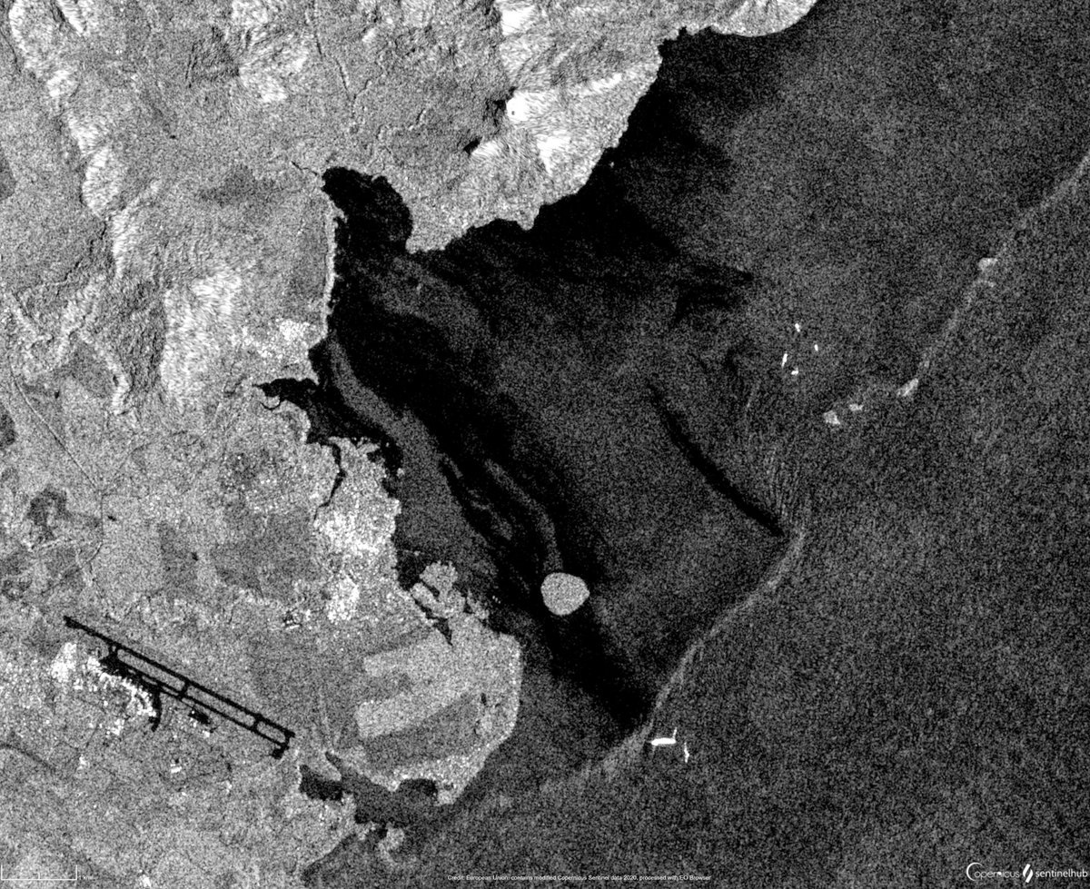

Neural Networks for
SAR Oil Spill Detection
Applied Data Science Project
Bianca Bartoli - s322799
Carlo Marra - s334220
Alessandro Valenti - s328131

Slide 2
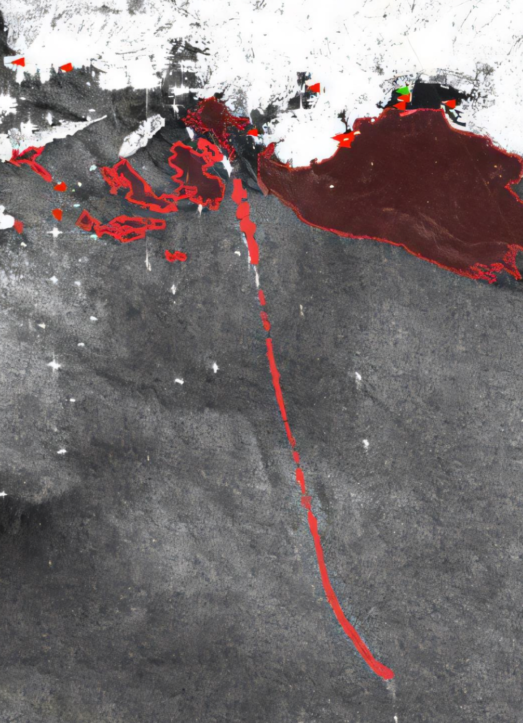





VALUE PROPOSITION
Main goal of the project: developing models to enable continuous monitoring and precise detection of oil spills
Oil spills pose a significant threat to marine ecosystems
Environmental Impact
Faster response times can significantly reduce the environmental damage caused by oil spills
Response Efficiency
Early detection and response help contain the spill, reducing the resources needed to manage its spread
Scalability
The developed system can be applied to any marine environment with SAR imaging availability, offering potential for global deployment

Slide 3
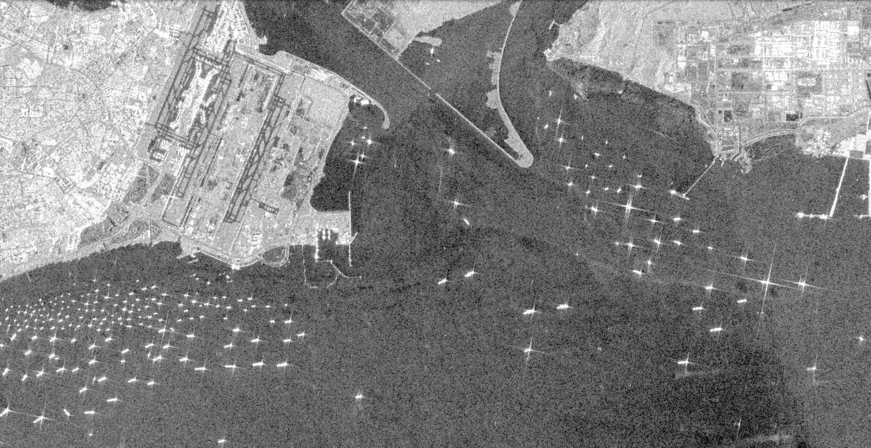


TASKS
Introduction:
Understand the oil spill issue
Review reference papers and resources
Paper replication:
Explore the dataset
Build a functional pipeline
Apply paper-specific augmentations
Reproduce all models
Evaluate and compare results
Development of improvements:
Design and test tailored augmentations
Implement and test CBDNet

Slide 4
GANTT
1st Call
October 2024
November 2024
December 2024
January 2025
Project Management
Research and Familiarization
Data Exploration & Preprocessing
Model Implementation and Training
Evaluation and Comparison
Documentation & Communication
Checkpoint 3

Slide 5
RESEARCH
QUESTIONS

Slide 6



ACCURACY
Which ML model provides the best performance for oil spill segmentation in SAR images (IoU)?
How does IoU performance vary across different classes?
Are certain models better at distinguishing ships, oil spills, or look-alikes?
DATA AUGMENTATION
How does augmenting SAR images influence the detection of oil spills?
Which augmentation techniques lead to more effective oil spill detection?
COMPUTATIONAL EFFICIENCY
Balancing accuracy and efficiency:
What are the trade-offs?
Can lightweight models achieve competitive accuracy?

Slide 7
DATASET
EXPLORATION

Slide 8
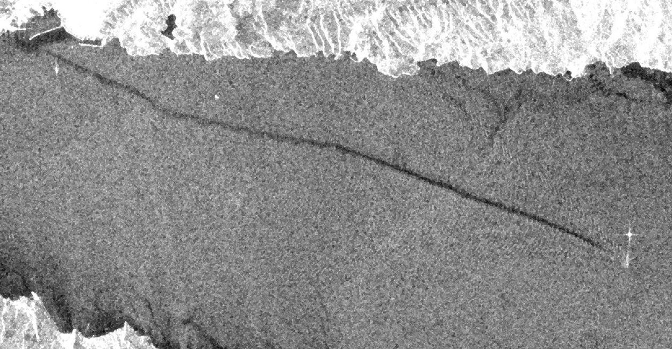
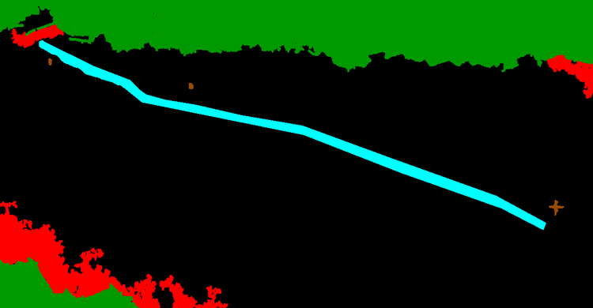

Images are taken by the ESA Satellite Sentinel-1
All images have dimensions 1250 x 650
Patches of dimension 320 x 320 are fed to models
4
1
0
3
2
Original SAR image
Ground truth mask
Explicit labels mask
3 greyscale identical channels
3 rgb channels
1 label channel
Sea Surface
0
Sea Surface
Oil Spill
1
Oil Spill
Look-alike
2
Look-alike
Ship
3
Ship
Land
4
Land

Slide 9
DATA PREPROCESSING

Slide 10
PAPER AUGMENTATIONS
Starting from the original image, the original paper performs:
Original Image
Random resize
with a scale from 0.5x to 1.5x
320x320 Crop
Horizontal Flip
with a probability of 50%
Augmented Image
Vertical Flip
with a probability of 50%

Slide 11
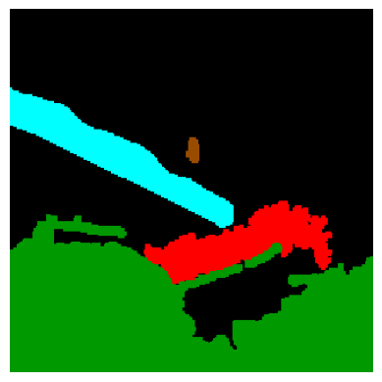
PAPER AUGMENTATIONS
Starting from the original image, the original paper performs:
Random resize
with a scale from 0.5x to 1.5x
320x320 Crop
Horizontal Flip
with a probability of 50%
Vertical Flip
with a probability of 50%

Slide 12
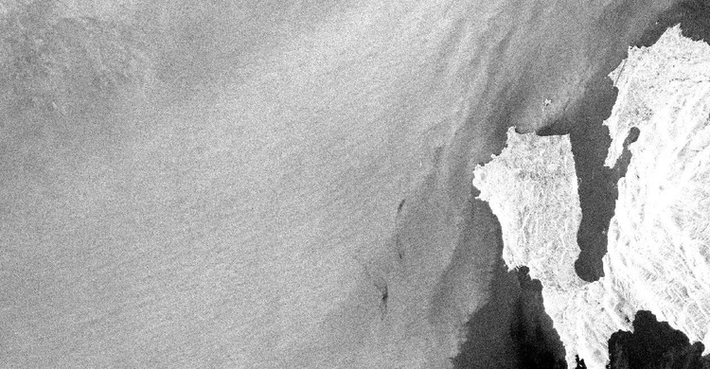
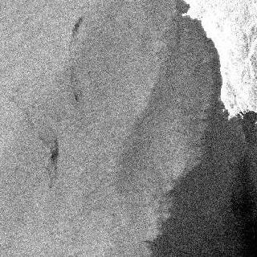
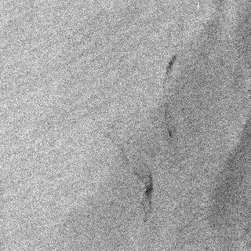

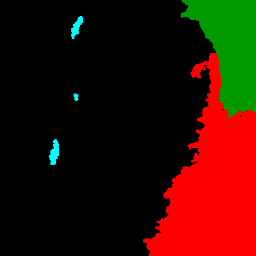
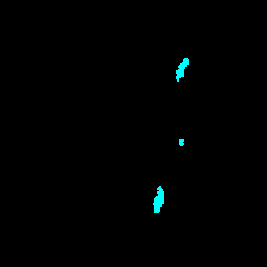
PROPOSED AUGMENTATIONS
Focused Crop on Oil Spill
Original Image
Focused Crop Examples
Sliding window for the Crop
Despeckling

Slide 13
IMPLEMENTATION
& TRAINING

Slide 14
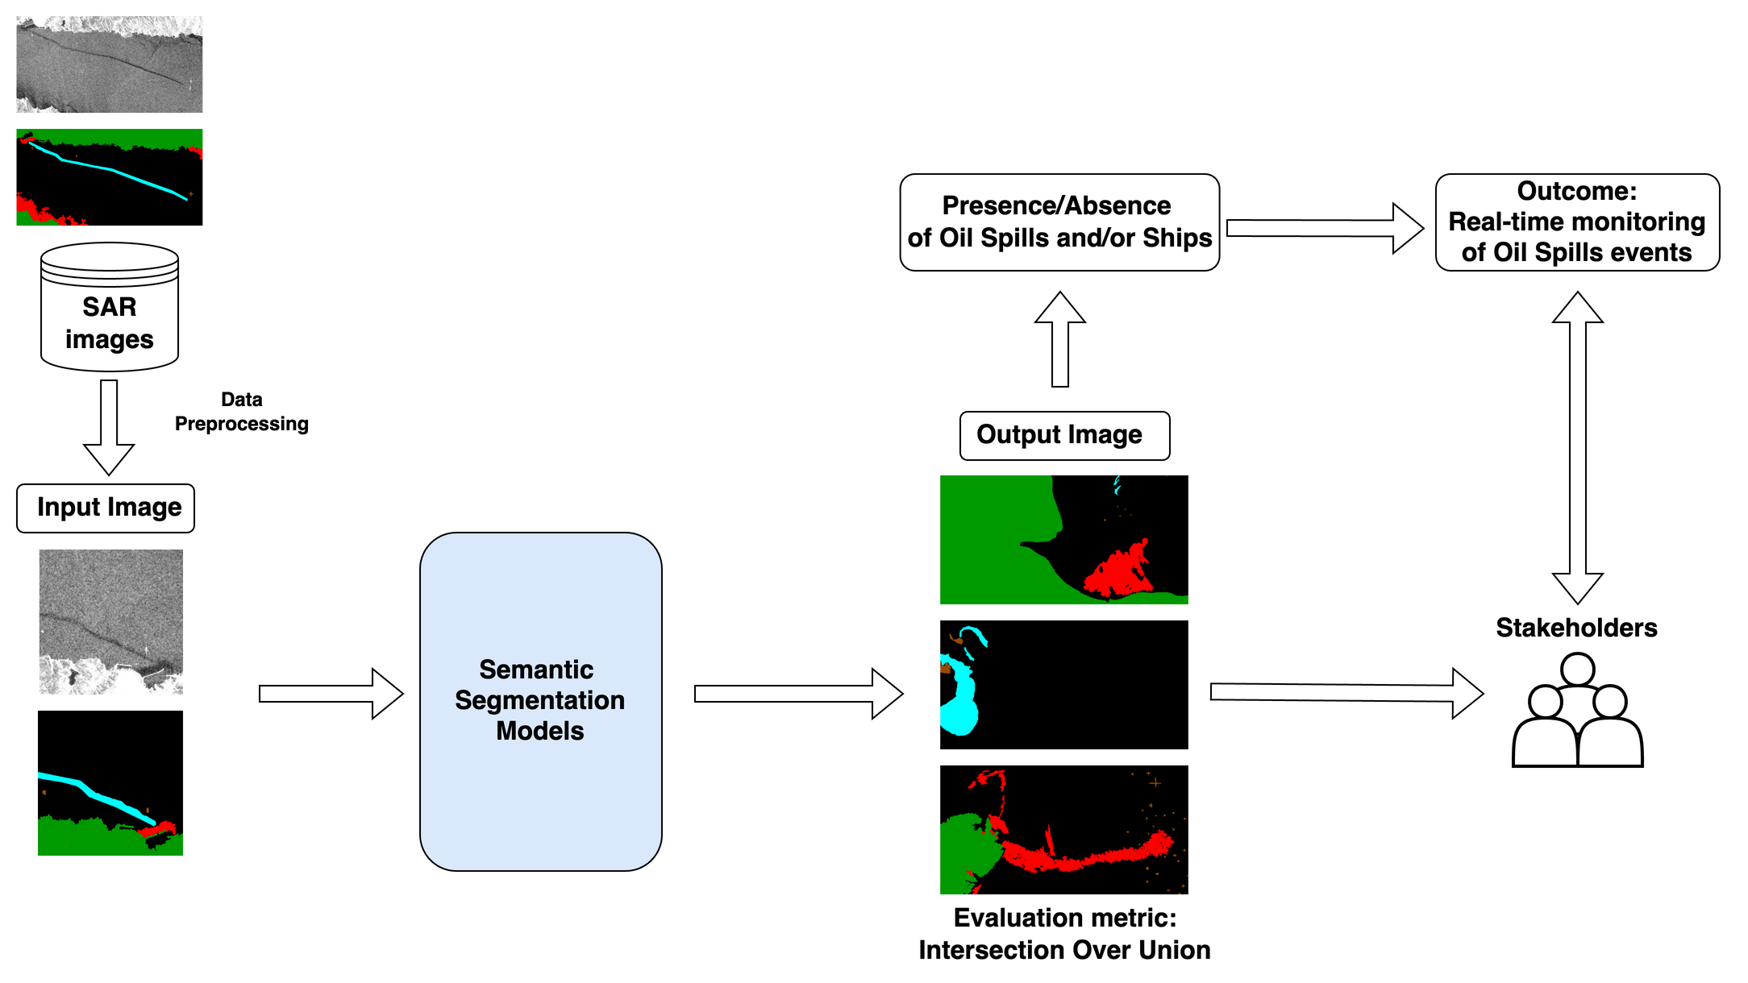
GENERAL OVERVIEW

Slide 15
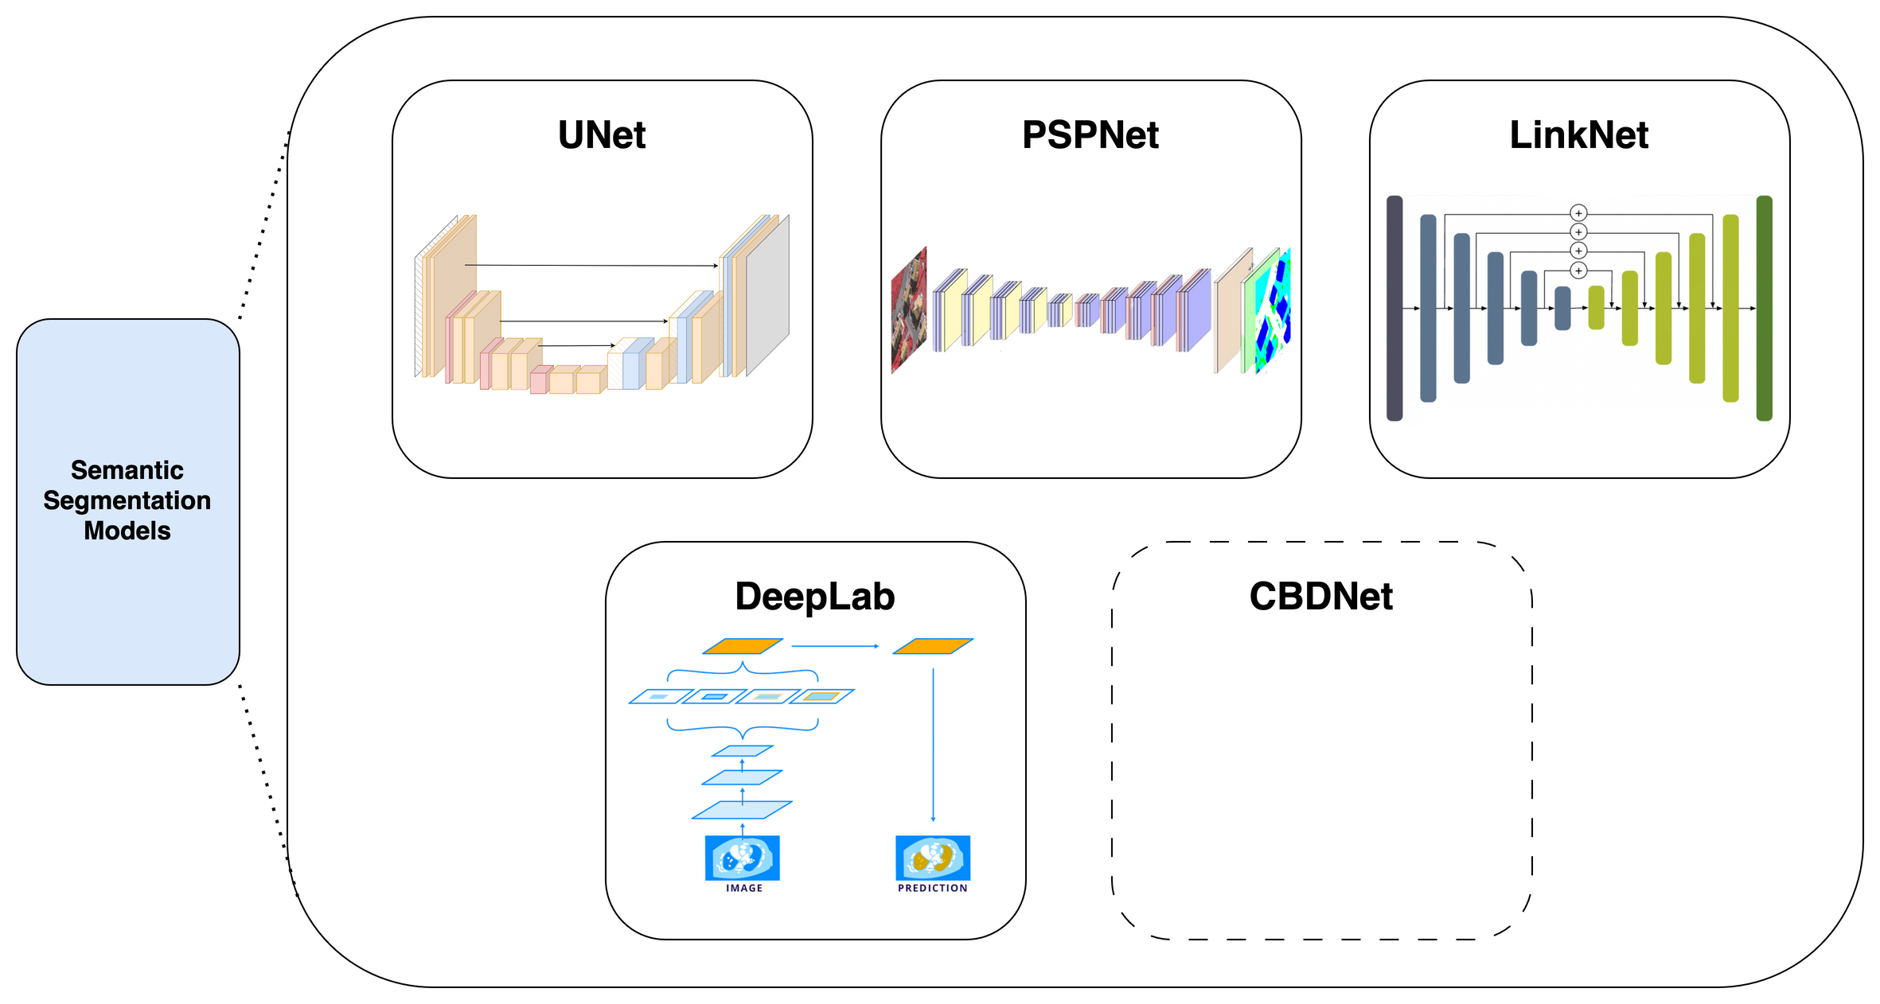
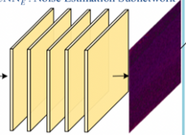
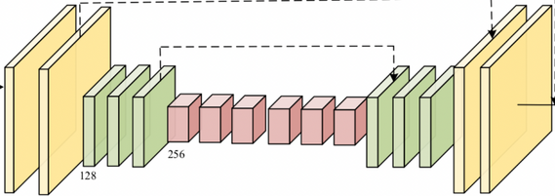
MODELS

Slide 16

TRAINING METHOD
Training framework:
Dataset:
We chose PyTorch Lightning for its modular workflow, which simplifies data handling, training, and testing, ensuring efficient and organized development.
We deal with an imbalanced dataset. To account for it, we applied this weighting scheme to the loss function of the trained models:
Class | Pixels | Loss Weight
Sea Surface | 797.7M | 1
Oil Spill | 9.1M | 2
Look-alike | 50.4M | 1
Ships | 0.3M | 4
Land | 45.7M | 1
Model Details:
Model | Backbone Architecture | Learning rate
U-Net | ResNet-101 | 0.0001
LinkNet | ResNet-101 | 0.00005
PSPNet | ResNet-101 | 0.0001
DeepLab3 | MobileNet3 | 0.0001

Slide 17
EXPERIMENT
& RESULTS

Slide 18
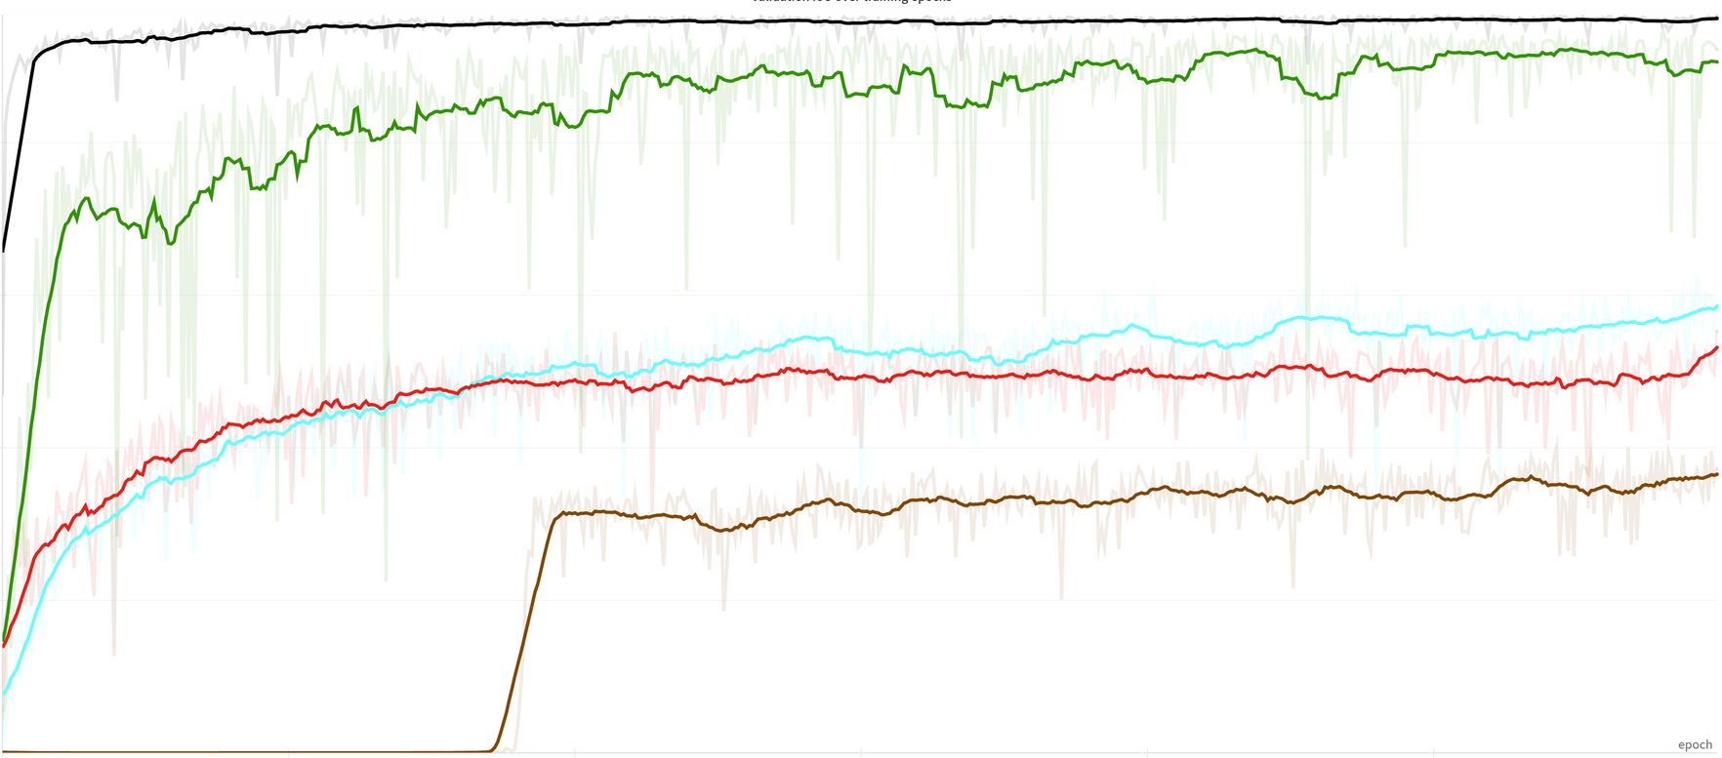
UNET
1.0
Class Label | IoU Score
Sea Surface | 0.9555
Oil Spill | 0.5554
Look-alike | 0.4918
Ships | 0.2672
Land | 0.9500
Mean IoU | 0.6440
0.8
0.6
0.4
0.2
0
100
200
300
400
500
600
Sea Surface
Oil Spill
Look-alike
Ship
Land
The graph shows the running average IoU of all classes over 20 training epochs.
Metrics from test set predictions
Total Training Time: 2h 26m 40s

Slide 19
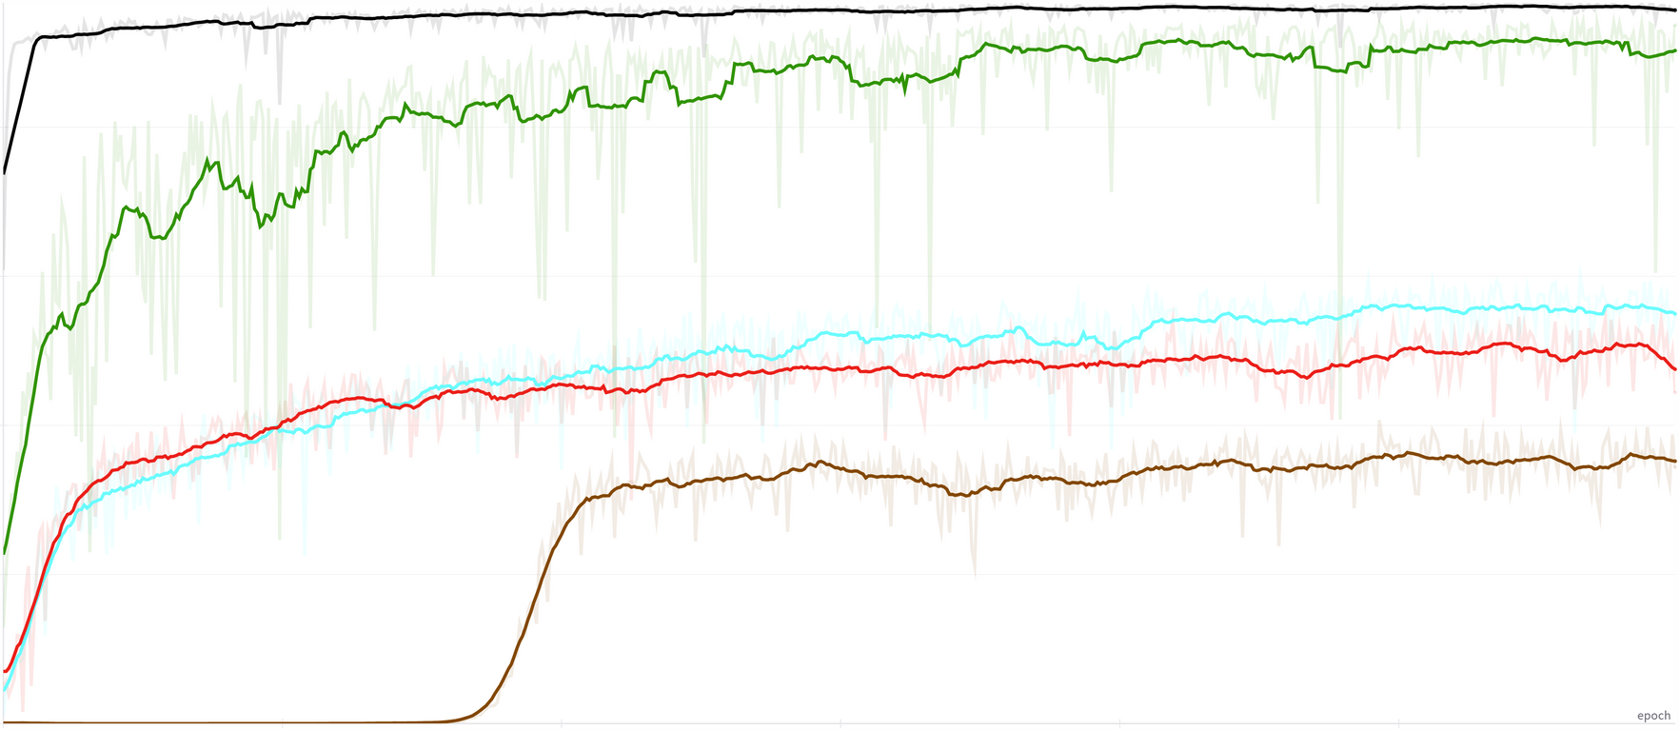
LINKNET
1.0
Class Label | IoU Score
Sea Surface | 0.9527
Oil Spill | 0.5485
Look-alike | 0.4247
Ships | 0.3405
Land | 0.9326
Mean IoU | 0.6398
0.8
0.6
0.4
0.2
0
100
200
300
400
500
600
Sea Surface
Oil Spill
Look-alike
Ship
Land
Total Training Time: 2h 22m 6s

Slide 20
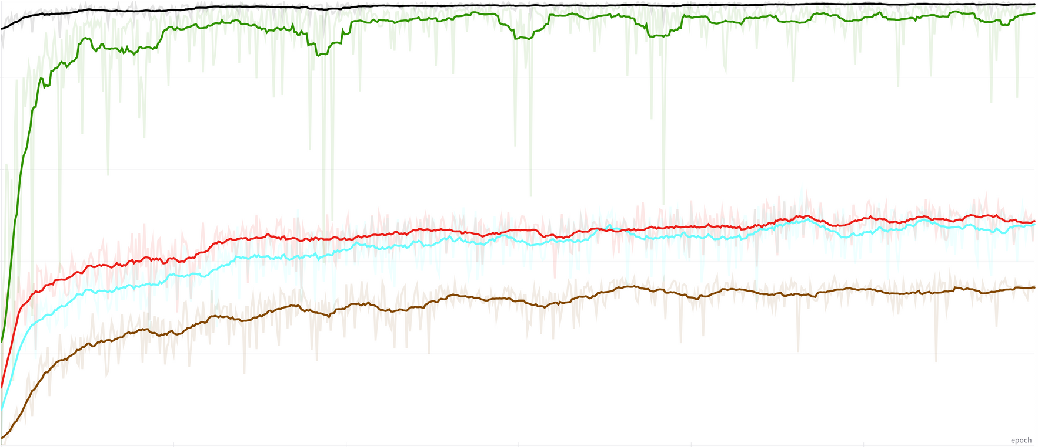
PSPNET
1.0
Class Label | IoU Score
Sea Surface | 0.9327
Oil Spill | 0.4444
Look-alike | 0.3652
Ships | 0.2141
Land | 0.9485
Mean IoU | 0.5810
0.8
0.6
0.4
0.2
0
100
200
300
400
500
600
Sea Surface
Oil Spill
Look-alike
Ship
Land
Total Training Time: 1h 21m 19s

Slide 21
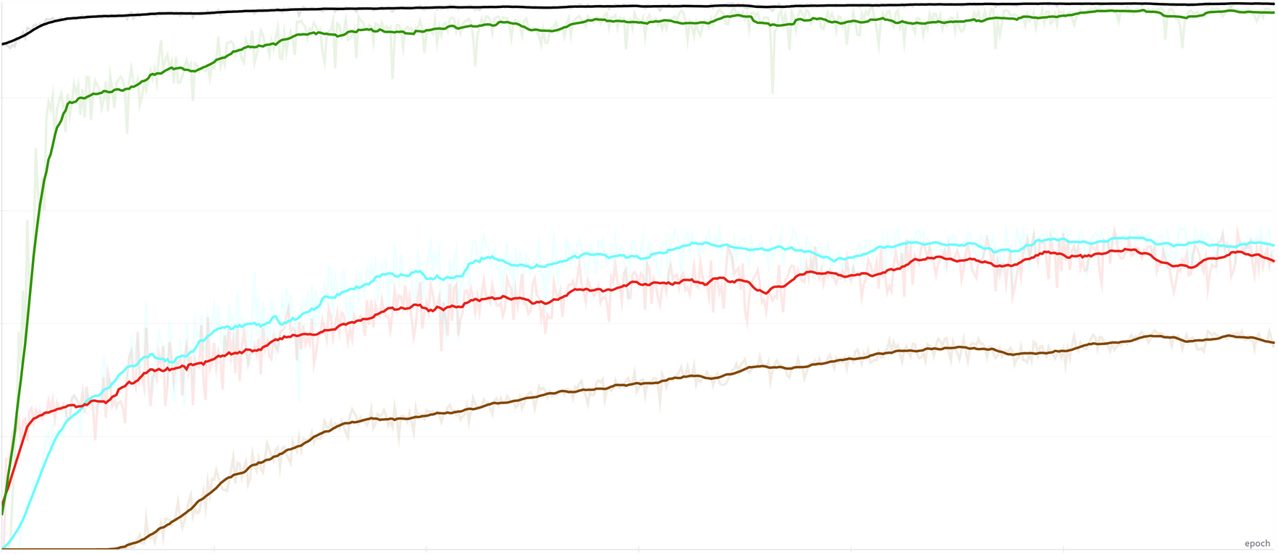
DEEPLAB
1.0
Class Label | IoU Score
Sea Surface | 0.9609
Oil Spill | 0.5262
Look-alike | 0.4874
Ships | 0.3131
Land | 0.9392
Mean IoU | 0.6453
0.8
0.6
0.4
0.2
0
100
200
300
400
500
600
Sea Surface
Oil Spill
Look-alike
Ship
Land
Total Training Time: 59m 47s

Slide 22
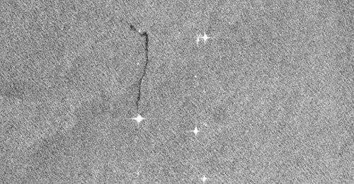
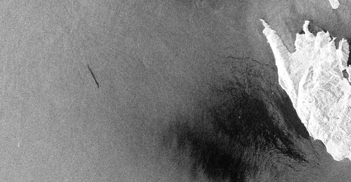
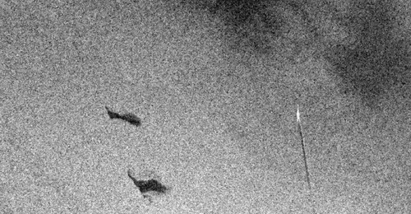
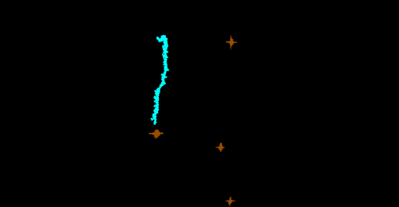
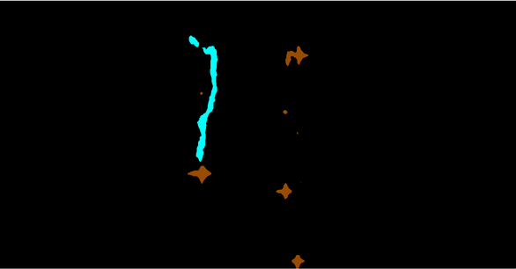
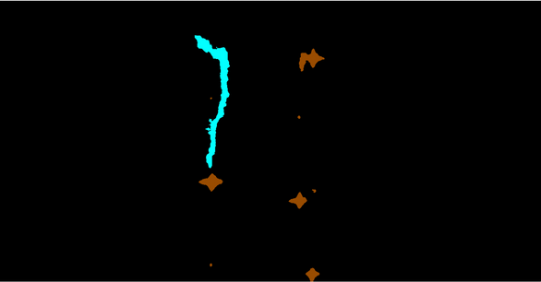
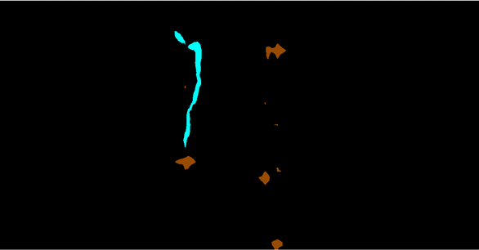
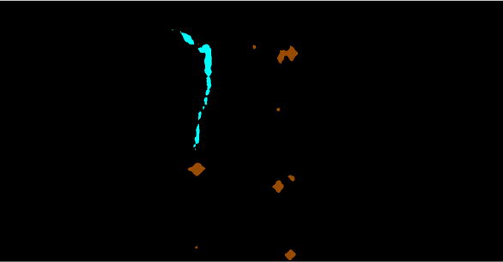
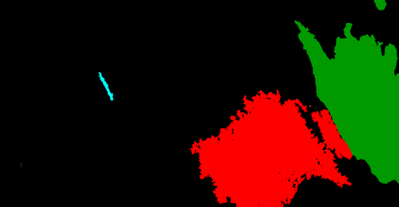
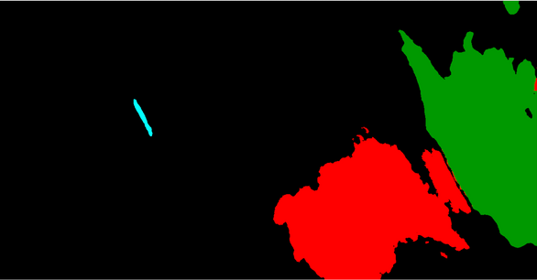
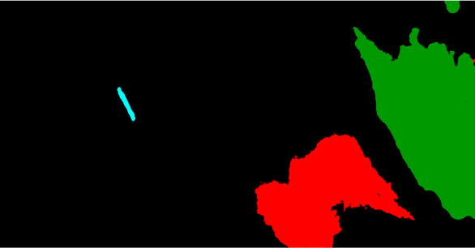

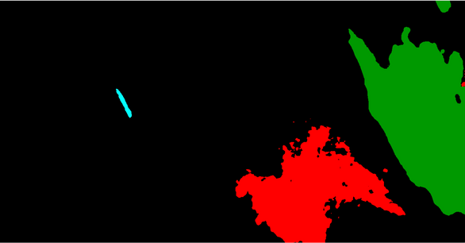
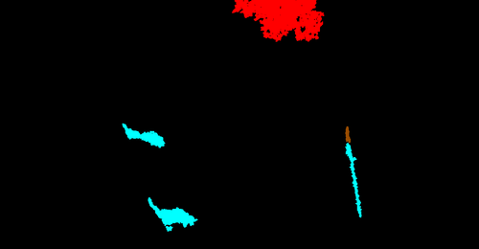
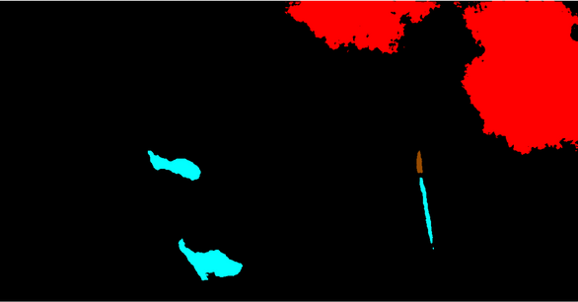
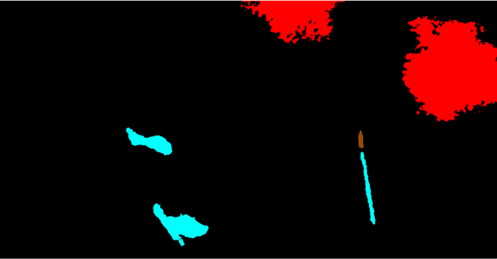
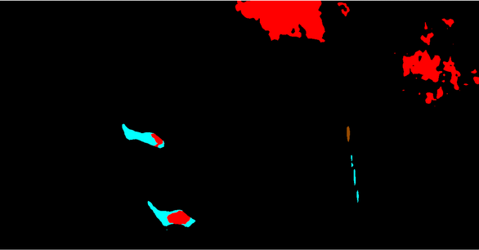
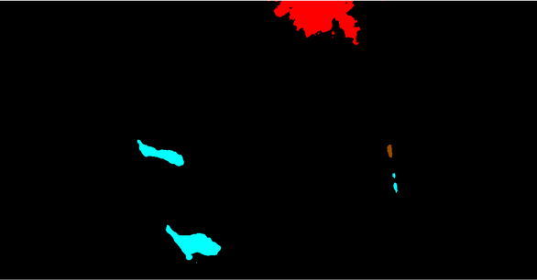
SEGMENTATION
COMPARISON
SAR Image
1
2
3
Ground Truth
U-Net
LinkNet
PSPNet
DeepLabV3+
1
2
3

Slide 23
FINAL COMPARISON
 | U-Net | LinkNet | PSPNet | DeepLabV3+
Sea Surface | 0.9555 | 0.9527 | 0.9327 | 0.9609
Oil Spill | 0.5554 | 0.5485 | 0.4444 | 0.5262
Look-alike | 0.4918 | 0.4247 | 0.3652 | 0.4874
Ships | 0.2672 | 0.3405 | 0.2141 | 0.3131
Land | 0.9500 | 0.9326 | 0.9485 | 0.9392
Mean IoU | 0.6440 | 0.6398 | 0.5810 | 0.6454

Slide 24
Thank you for your attention
Any questions?
Bianca Bartoli - s322799
Carlo Marra - s334220
Alessandro Valenti - s328131

Slide 25
Thank you for your attention
Any questions?
Bianca Bartoli - s322799
Carlo Marra - s334220
Alessandro Valenti - s328131

Slide 26
Thank you for your attention
Any questions?
Bianca Bartoli - s322799
Carlo Marra - s334220
Alessandro Valenti - s328131

Slide 27
Thank you for your attention
Any questions?
Bianca Bartoli - s322799
Carlo Marra - s334220
Alessandro Valenti - s328131

Slide 28
CBDNET
1.0
Class Label | IoU Score
Sea Surface
Oil Spill
Look-alike
Ships
Land
Mean IoU
0.8
0.6
0.4
0.2
0
100
200
300
400
500
600
Sea Surface
Oil Spill
Look-alike
Ship
Land
Sea Surface
Oil Spill
Look-alike
Ship
Land

